Slide 1




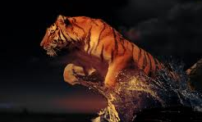


unconventional
unusual
unexpected
surprising
cunning
confrontational
sly
calm
quiet
intelligent
loud
threatening
clever
arrogant
calculating
aggressive
scheming
menacing
superior
status
comparison
simile
disguise
position
-Rich
- Upper classes
-Often female
unpleasant
physique
organisation
poisonous
information
knowledge
dangerous
split-personality
skill
looks
predatory

Slide 2
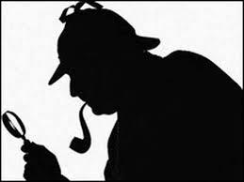
Explore the ways in which Conan Doyle presents the villains in two Sherlock Holmes stories, making reference to villains in other stories in the collection.
This Controlled Assessment consists of 4 elements which we will tackle in 4 separate sections:
Introduction – What is the role of the villain in a Sherlock Holmes story?
How does Conan Doyle present …… as the villain
[INTRO to section - In this story the villain is … who …]
3. How does Conan Doyle present …… as the villain?
4. Is there a pattern in Conan Doyle’s presentation of
villains in his Sherlock Holmes stories?

Slide 3
Introduction
The Sherlock Holmes stories by Sir Arthur Conan Doyle, all contain interesting villains. The villains have characteristics which make them stand out. The actions are surprising and unusual. In terms of intelligence, the villains are often smarter than the police. Their personalities are arrogant and aggressive. All villains believe they are highly skilled and organised.

Slide 4
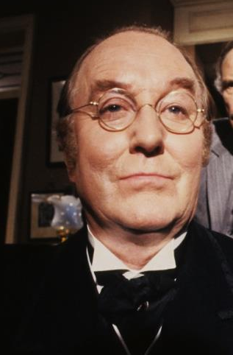
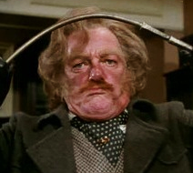
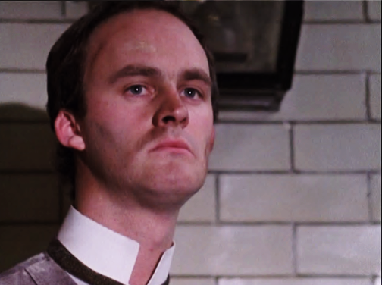
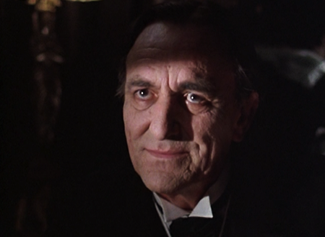
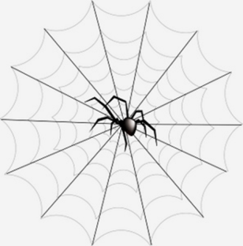
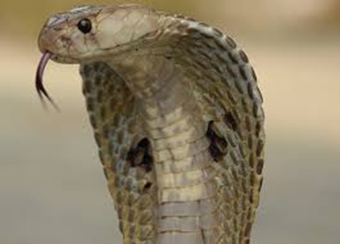
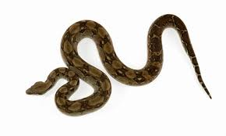
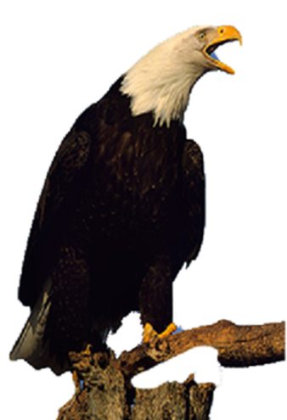
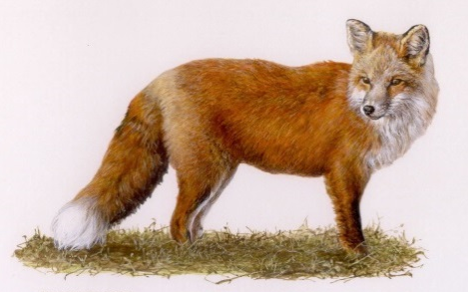
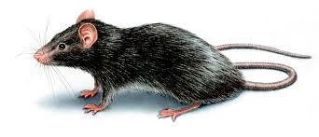
Section 2: Choose 2 villains to analyze in more detail
Match the animal comparison to the villain

Slide 5
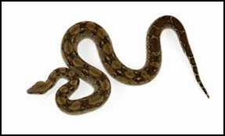
"The Adventure of the Speckled Band" is a Sherlock Holmes short story by Sir Arthur Conan Doyle; its plot centers around Holmes and his assistant, Dr. John Watson, as they solve a mystery for client Helen Stoner, whose twin sister died under mysterious circumstances that cause Helen to fear for her own life. The title refers to the last words of Helen's twin, Julia, who said, "...the band! The speckled band!" before dying. In the story, Helen lives with her stepfather, Dr. Roylott, in an old mansion, and, in circumstances that mirror Julia's death, Dr. Roylott has requested that Helen sleep in a particular room in the days before her wedding.
The room in which Julia died and in which Helen is supposed to sleep is adjacent to Dr. Roylott's room, and it has several strange features, including the fact that the bed is bolted to the ground and cannot be moved, and there is a mysterious cord hanging over the bed that runs up into the room's vent. It turns out that Roylott is responsible for Julia's death as the twins' mother, Roylott's deceased wife, left a will entitling her daughters to her money when they are married. Roylott used the cord as a means of transporting a deadly snake, a swamp adder, into the room. The snake is actually the speckled band that Julia mentions.

Slide 6
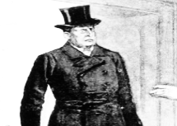
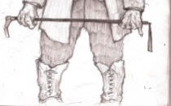

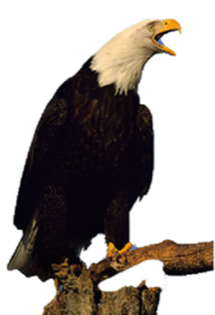
Dr Roylott – The Speckled Band
Student copy
“A large face … marked with every evil passion …”
“… his hat actually brushed the cross bar of the doorway, and his breadth seem to span it from side to side.”
“His costume was a peculiar mixture of the professional and the agricultural …”
“When a doctor does go wrong he is the first of criminals.”
“… poison which could not possibly be discovered by any chemical test ….”
“He had trained it …to return to him when summoned.”
“…violence of temper…”
“ … a fierce old bird of prey …”

Slide 7
2. First SQUID
In the Speckled Band, the villain is unusual. Dr Roylott who was once a good character, tries to kill his step-daughter for her money. He does this by training a snake to enter the room to deliver its poision. [S] Dr Roylott is a scheming and --- villain. [Q] An example of this is when --- says, “….” [U]

Slide 8




Professor Moriarty – The Final Problem
Student copy
y
“… a phenomenal mathematical faculty …”
“… incommoded … inconvenienced ….”
y
“… extraordinary mental powers …”
“ It is inevitable destruction.”
y
“… a man of good birth and excellent education”
“… brilliant career …”
y
“ … his face … oscillating … in a curiously reptilian manner …”
“… something of the professor in his features …”

Slide 9
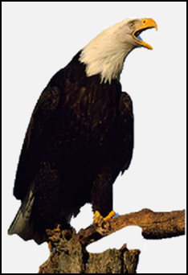
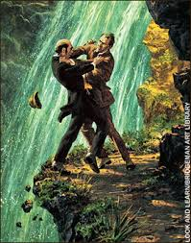
After a four month absence, Sherlock Holmes returns to Baker Street following several attempts on his life. Holmes had been away on an important assignment for the French government - recovering the Mona Lisa that had bee stolen from the Louvre. He was successful in his task and appropriately rewarded by the French but he raised the ire of the crime's perpetrator - Professor Moriarty. On the morning of his return, the Professor visited Holmes in his flat and warned him to cease or he would have no choice but to take extreme measures. With several attempts on his life having already taken place, Holmes and Watson head for Switzerland. Moriarty is a relentless pursuer however and he and Holmes have a fateful encounter at the Reichenbach Falls.

Slide 10
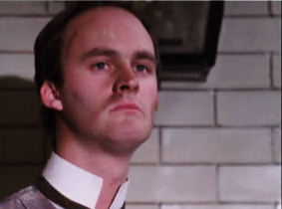


John Clay – The Red Headed League
Student copy
“… He is … the fourth smartest man in London, and for daring I am not sure that he has not a claim to be third…….”
“… the murderer, thief, smasher, and forger …he is at the head of his profession.”
“His grandfather was a royal duke, and he himself has been to Eton and Oxford. ”
“We have stopped all the holes. ”
“You seem to have done the thing very completely. I must compliment you.” [bows to Holmes and Watson]
To:
To:
“I beg that you will not touch me with your filthy hands …”
To:
“ … You may not be aware that I have royal blood in my veins …”

Slide 11
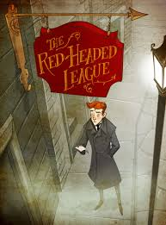
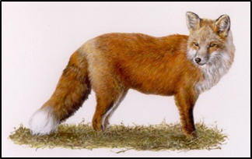
Sherlock Holmes in investigates the strange case of Jabez Wilson. The man was recently offered employment by an organization known as the Red Headed League. For the grand sum of 4 pounds per week, he was to sit in an office and copy out entries from an encyclopedia, starting with the letter A. He had responded to an advertisement and while there were many applicants, he has no idea why he was selected as the League's beneficiary. When after several weeks his employment is suddenly terminated, Mr. Wilson doesn't know what think. Holmes quickly deduces however that it was the location of his office as much as his red hair that resulted in him getting the employment in the first place.

Slide 12
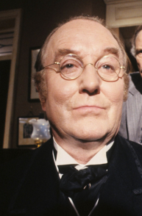
The adventure of Charles Augustus Milverton
Student copy
“… A creeping, shrinking sensation … before the serpents in the zoo … “
“… slithery, gliding, venomous creatures ...”
“… a smiling face and a heart of marble ....”
“.. He will squeeze and squeeze until he has drained them dry … ”
“… the fixed smile and … the hard glitter of those restless and penetrating eyes ...”
“… gliding as quick as a rat …”
“Let us get down to business.”
“ … It is painful for me to discuss it …”

Slide 13
Section 2: First villain: name and story
Family background, past career, criminal activity
Key features: his actions, his scheme, his way of speaking or the way he is described?
S
Q
U
I
D
S
Q
U
I
D
S
Q
U
I
D
What is most effective about the way Conan Doyle presents him as a villain?

Slide 14
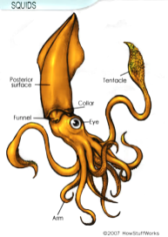
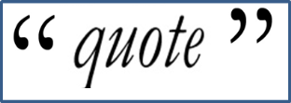
Pushing for Top Grades
A
Student copy
C
B
S
tate
Point in structure
Unusual or not
Unconventional or not
Q
uote
Embed
Embed
U
npick
Explain technique
Explain associations
Explore connotations
I
mpact
Comment on effect
Effect: then v now
Alt. int: might … could …
D
eeper
Explore ideas of criminal intelligence
Explore ideas of predator v food chain
Explore similarities & differences (Holmes v villain)

Slide 15
Section 3 - Second villain: name and story
Family background, past career, criminal activity
Key features: his actions, his scheme, his way of speaking or the way he is described?
S
Q
U
I
D
S
Q
U
I
D
S
Q
U
I
D
What is most effective about the way Conan Doyle presents him as a villain?

Slide 16


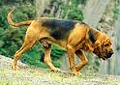


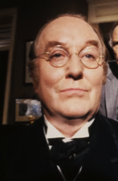
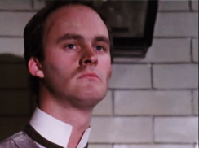


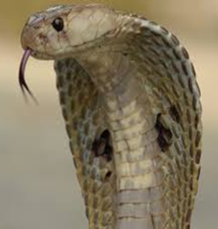
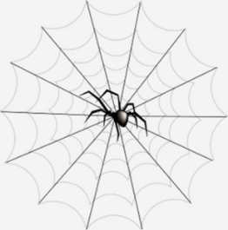

Intelligence
Motivation
Animal imagery
Section 4: Is there a pattern in Conan Doyle’s presentation of the villains? Spot the similarities and differences.

Slide 17
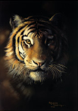


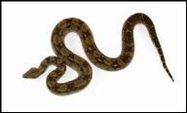

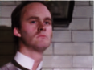


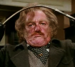



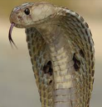
Paragraph 4 - Conclusion: Is there any pattern in the way Conan Doyle presents the villains?
NB mention some of the other villains we have studied
Intelligence
Intelligence
Class background
Class background
Attitude to crime & the police
Attitude to crime & the police
Motivation
Motivation
In what ways are the villains similar to or different from the great detective?

